Slide 1


Hill Cipher
M. Sathvika LA3
V. Vaishnavi L59
S. Prashamsa L69
T. Adilakshmi L79
J. Srivarsha L99
P.Spandhana 1751

Slide 2
What is Hill Cipher:
A Hill cipher is a polygraphic substitution cipher that encrypts plaintext by applying linear algebra techniques.
It uses matrix multiplication with a numerical representation of the plaintext, where a key matrix (which must be invertible) transforms blocks of character into cipher text.
The process involves modular arithmetic, typically modulo 26 for the English alphabet, making it more complex and secure than simpler ciphers

Slide 3
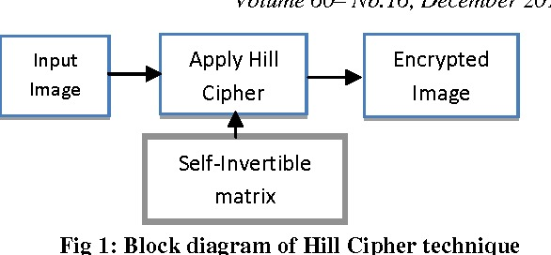
Block Diagram:

Slide 4
Encryption process:
Step 1: Process Convert plaintext to numerical form:
Assign 𝐴=0,𝐵=1,…,𝑍=25
For example, "ACT" becomes [0219]
Step 2: Multiply the plaintext vector by the key matrix:
Multiply 𝐾×𝑃, where 𝑃 is the plaintext vector
Cipher Vector (𝐶)=𝐾×𝑃mod 26
Step 3: Convert back to letters:
Convert the numerical ciphertext back to letters using the reverse mapping
(e.g., 0=𝐴,1=𝐵,…,25=𝑍0=A,1=B,…,25=Z).

Slide 5
Decryption Process:
Step 1: Decryption Process Find the inverse of the key matrix:
The decryption key is 𝐾−1 mod26. Compute it using the matrix inverse formula and modulo arithmetic.
Step 2: Multiply the ciphertext vector by the inverse key:
Multiply 𝐾−1×𝐶mod 26, where C is the ciphertext vector.
Step 3: Convert back to plaintext:
Convert the numerical values back to letters.

Slide 6
Advantages:
Simplified key management (same matrix for encryption and decryption).
Reduced computational effort (no need to calculate inverse).
Easy verification (𝐴2=𝐼).
Symmetry in encryption and decryption operations.
Compatibility with modular arithmetic in cryptography.

Slide 7
Applications:
1.Educational Purposes: Teaching encryption, decryption, and matrix operations in cryptography and linear algebra.
2.Historical Cryptography: An early example of block ciphers with mathematical foundations.
3.Lightweight Encryption: In low-security or resource-constrained systems.
4.Research and Cryptanalysis: Studying cryptographic vulnerabilities and cipher design.
5.Puzzles and Games: Providing practical examples of encryption in challenges.

Slide 8
THANKYOU

